Slide 1
MINI PROJECT
STUDENT MANAGEMENT SYSTEM
GUIDED BY:
Ms.D.MERLIN GETHSY AP/CSE
PRESENTED BY:
S.LATHA SELVAM -953419104030
P.MALATHI-953419104031
O.MEENATCHI-95341910033
R.SALMA JESHRAN-953419104044

Slide 2
ABSTRACT:
In student management system we can register as a user and manage the details of student details and attendance.
All students can search his/her basic details and attendance status with their respective roll number.
An administrator has the power to add the new user and can edit the student details entered

Slide 3
INTRODUCTION:
The student management system is to allow the administrator of any organization to edit and find out the personal details of a student allows the student to keep up to date his profile.
Student management system will store all the details of the students including their background information, educational qualifications, and all the information related to their resume.
The student management system is an automated version of manual student management system.
The student management system can handle all the details about a student.

Slide 4
LITERATURE SURVEY:
Title | Author | Advantages | Disadvantages
Online student information system | Igweonu(2013) | Acadamic transaction services | Inadequate technicians for computer maintainance

Slide 5
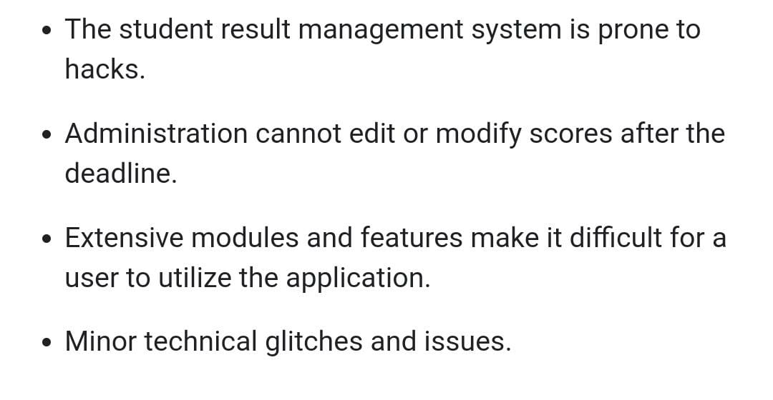
DRAWBACK OF EXISTING METHODS:

Slide 6
OBJECTIVE:
Student management system provide a simple interface for maintenance of student information.
The main objective of the student management is to manage the details of profiles ,courses ,fees and attendance.
The project works on python language and the database is MYSQL
The data that will be disclosed will be more secure since there will be no access to the unknown users.

Slide 7
FLOW CHART:
START
ADMIN
NO
LOGIN
YES
ADD DEPARTMENT
ADD USER
VIEW ATTENDANCE
REPORTS
STOP

Slide 8
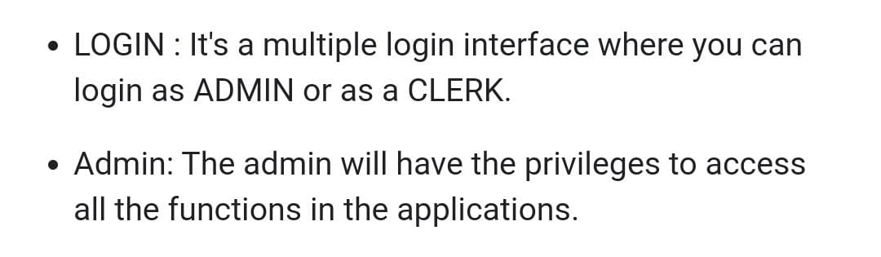
MODULES OF PROJECT:

Slide 9
ALGORITHM:
ADMIN:
Step 1 : Start
Step 2 : Login if Username and Password are valid
Step 3 : Else deny permission
Step 4 : After logging in, Admin can view the records
Step 5 : Admin can add/remove staffs/subjects
Step 6 : Logout

Slide 10
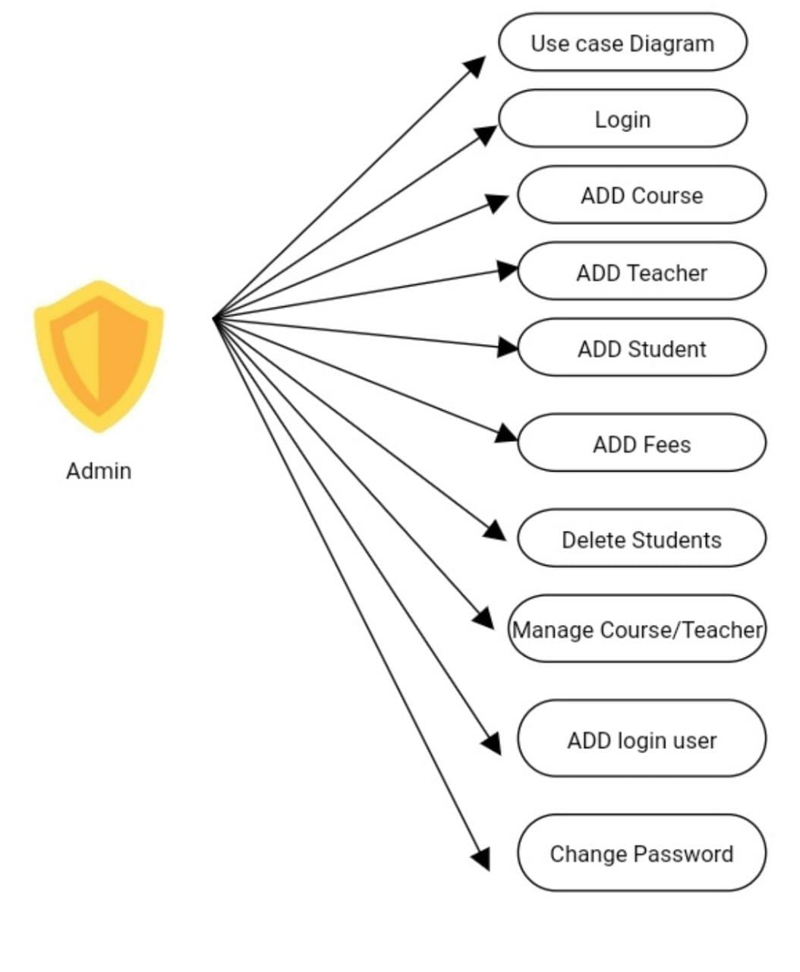
USE CASE DIAGRAM:

Slide 11
SOFTWARE AND HARDWARE REQUIREMENTS:
SOFTWARE REQUIREMENTS:
Frontend- HTML,CSS, Java script, Bootstrap
Backend- Python flask (Python 3.7) , SQLAlchemy
Operating systems: Windows 10
Google Chrome /Internet Explorer
XAMP(Version -3.7)
Python main editor (user interface): PyCharm Community
Workspace editor : Sublime text 3

Slide 12
HARDWARE REQUIREMENTS:
Computer with a 1.1 GHz or faster processor
Minimum 2GB of RAM or more
2.5 GB of available hard –disk space
5400 RPM hard drive
1366*768 or higher- resolution display
DVD-ROM drive

Slide 13
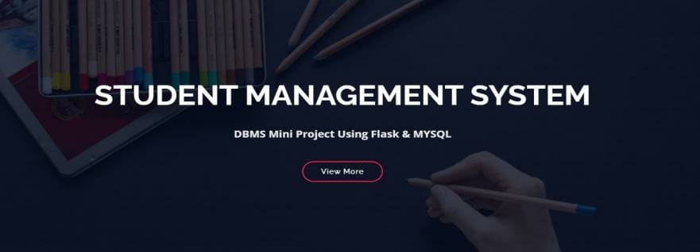

Slide 14
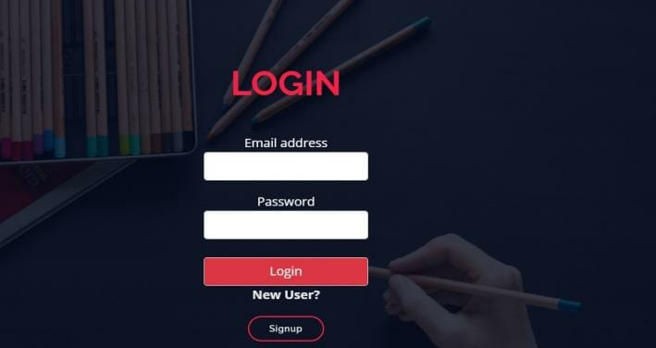

Slide 15
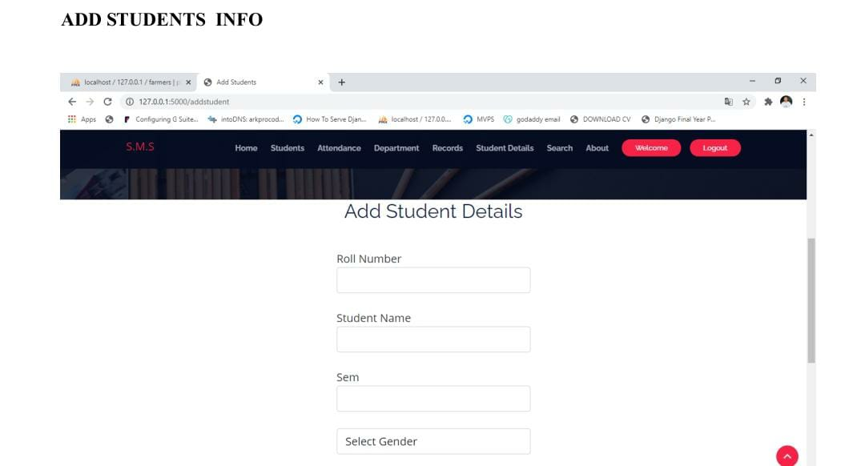

Slide 16
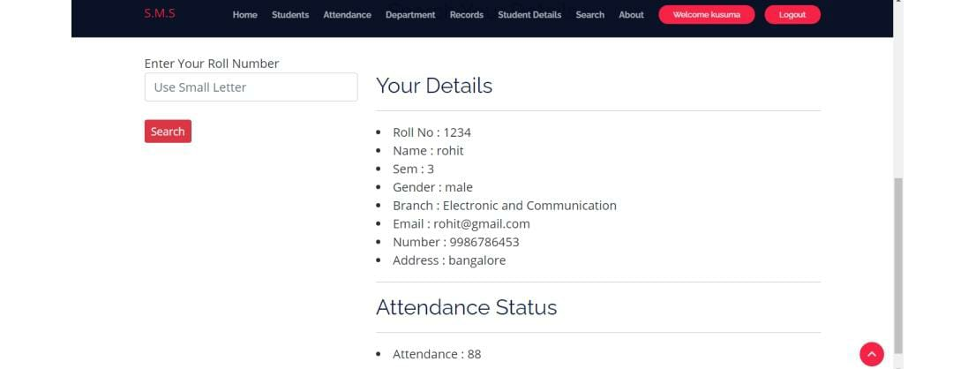

Slide 17
CONCLUSION:
Student management system successfully implemented based on online data filling.
Using MySQL as the database is highly benificial as it is free to download,popular and can be easily cutomized.
The data stored in the MySQL database can easily be retrieved and manipulated according to the requirement with basic knowledge of SQL.

Slide 18
REFERENCE:
Christ University https://christuniversity.in/StudentLogin.html
S. R. Bharamagoudar, R. B. Geeta, and S. G. Totad, “Web based student information management system,” International Journal of Advanced Research in Computer and Communication Engineering, vol. 2, no. 6, 2013.
Pressman, Roger S., Software Engineering, fifth edition, McGraw-HillHigher Education, 2001.

Slide 19
THANK YOU

